Slide 1

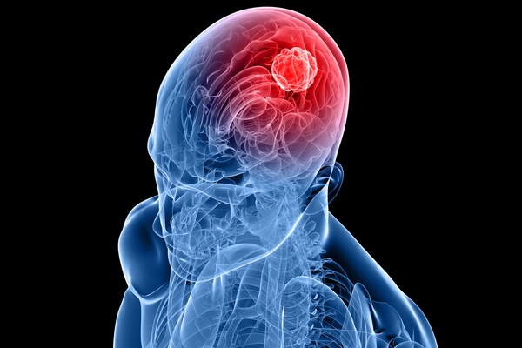
BRAIN TUMOR
CLASSIFICATION
.
USING DEEP LEARNING (CNN)
PRESENTED BY: AMALJITH P

Slide 2

Introduction
Using deep learning, we can automatically classify brain tumors and help doctors make faster and more accurate decisions.
Detecting brain tumors is very important for saving lives.
There are different types of brain tumors which make diagnosis difficult.
Manually verifying the MRI images for an early detection is time consuming, which can impact the patient’s health.

Slide 3
.
Objective
To build a predictive model that accurately detects and classifies brain tumors from MRI images, helping doctors diagnose faster and more reliably.
To deploy the trained model as a web application on AWS for accessible and real-time predictions.

Slide 4
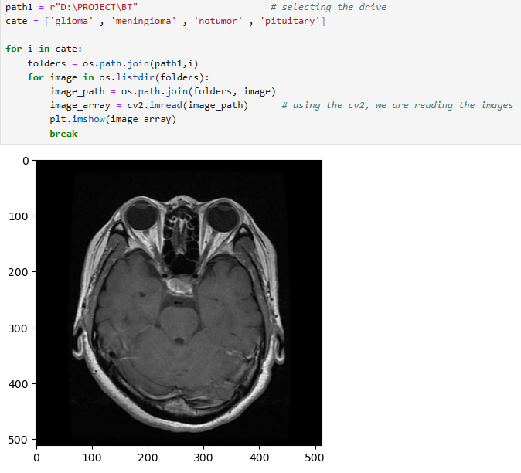
Introduction to Dataset
Total Images : 30462
Categories : Glioma, Meningioma, Pituitary and No Tumor

Slide 5
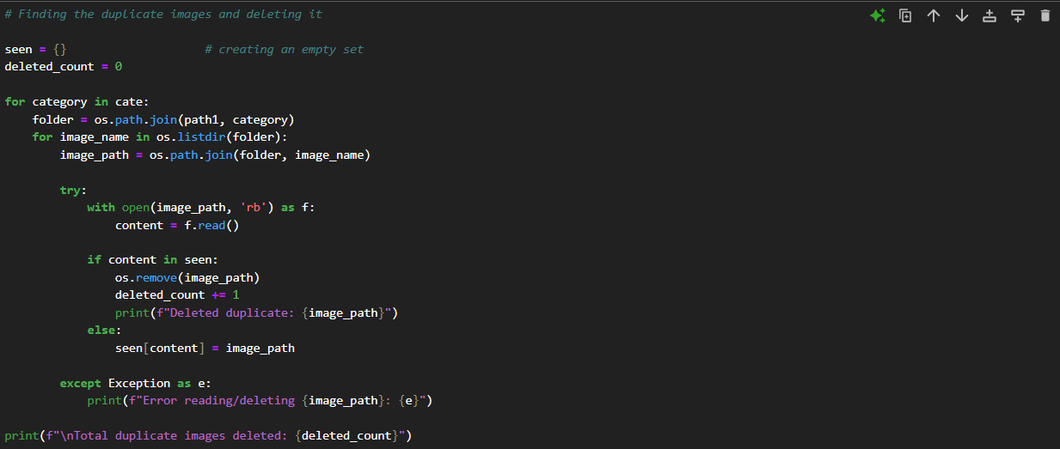
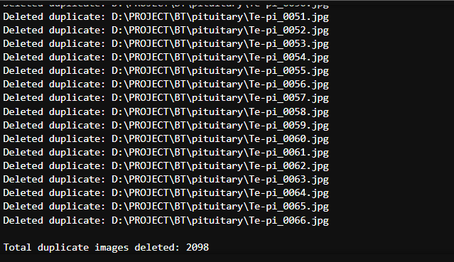
Data Preprocessing
Checking for any duplicate images and deleting it
Output
This makes our total images to 28364

Slide 6
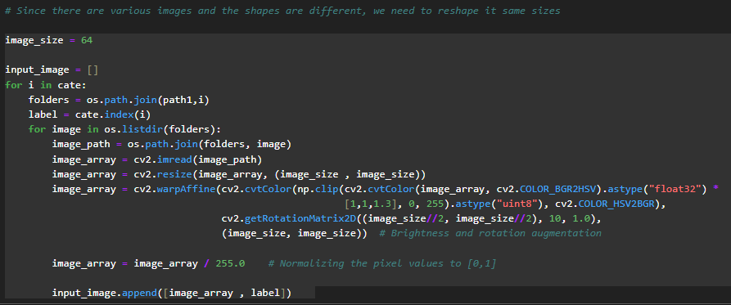
Using Data Augmentation techniques like
Resizing to 64×64 pixels
Brightness enhancement using HSV color adjustment
Rotation of 10° to introduce variation
Pixel normalization (0–1 scaling)

Slide 7
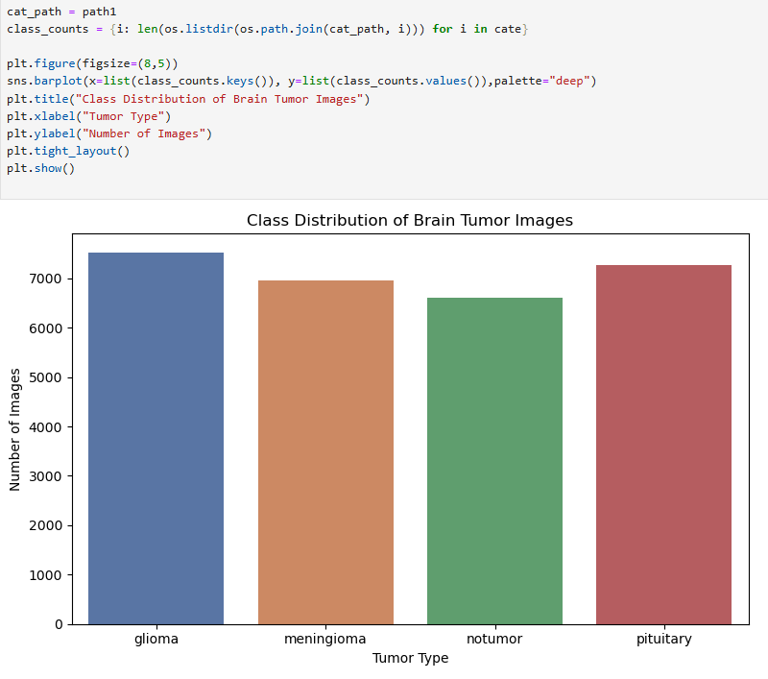
Data Distribution
Each class has around 7000 images

Slide 8
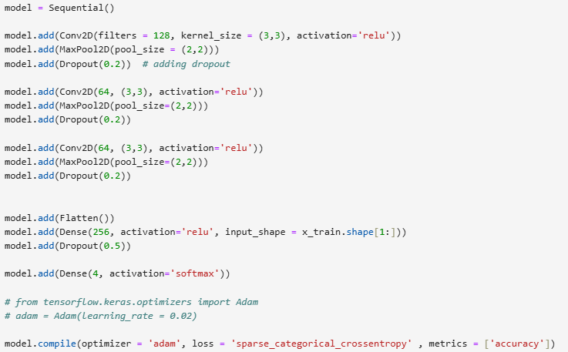

MODEL BUILDING
Built a CNN with 3 Conv2D + MaxPooling + Dropout layers for feature extraction.
Flattened output and added a Dense layer with 256 units and ReLU activation.
Final output layer uses Softmax for 4-class tumor classification.
Used Dropout (0.2 in conv blocks, 0.5 in dense layer) to reduce overfitting.
Compiled using Adam optimizer and sparse categorical cross-entropy loss.
Evaluated using accuracy as the performance metric.

Slide 9
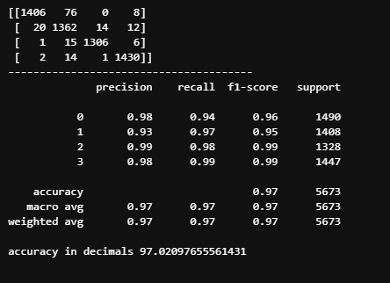
Model Evaluation
On Test Data

Slide 10
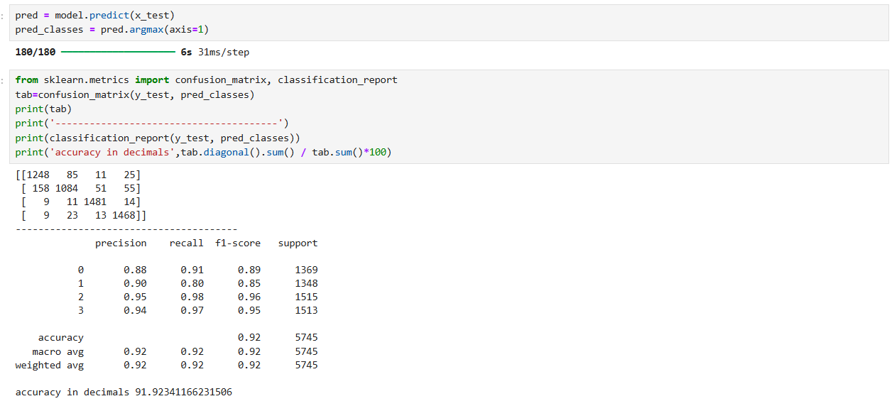
.
Challenges
Initial model performance was below expectation.
Need to find the optimal combination of hyperparameters to improve results.

Slide 11
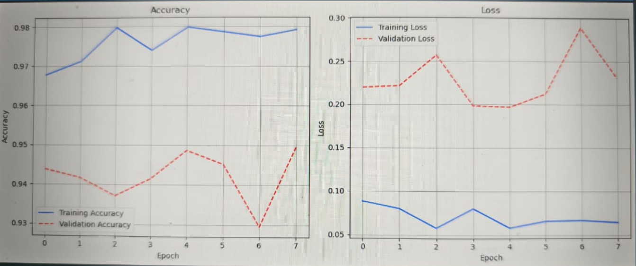
Model Training & Validation Performance
OVERFITTING MODEL

Slide 12
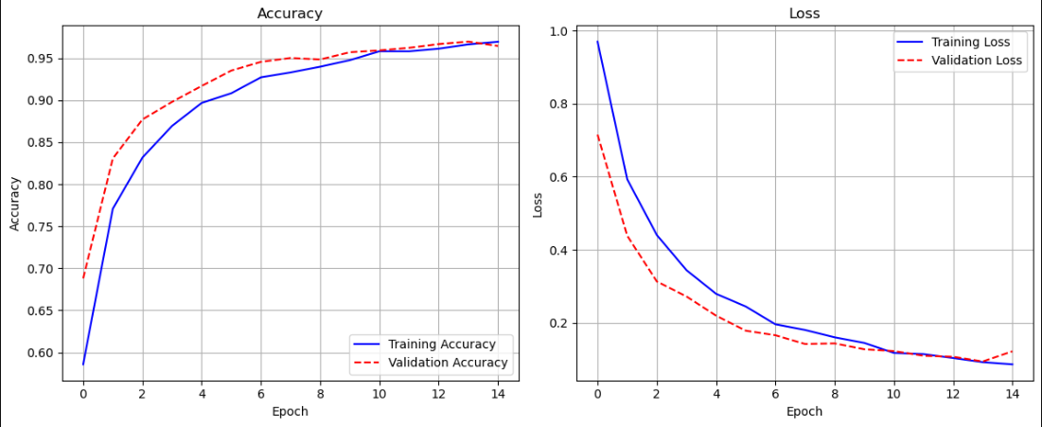
FINAL MODEL

Slide 13
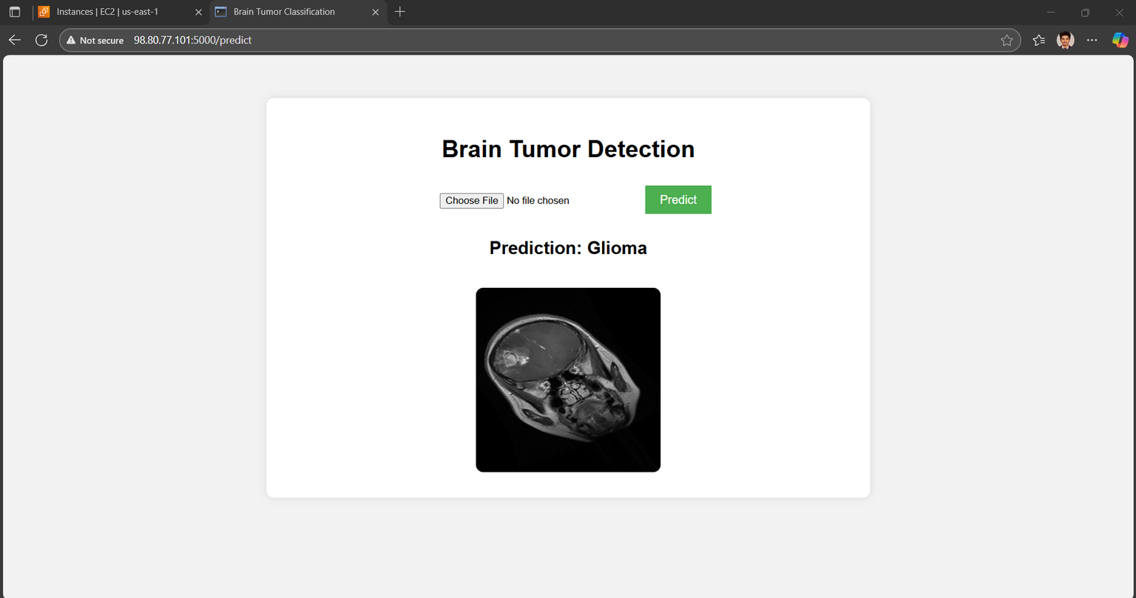
.
Model Deployment
Deploying the model on AWS

Slide 14
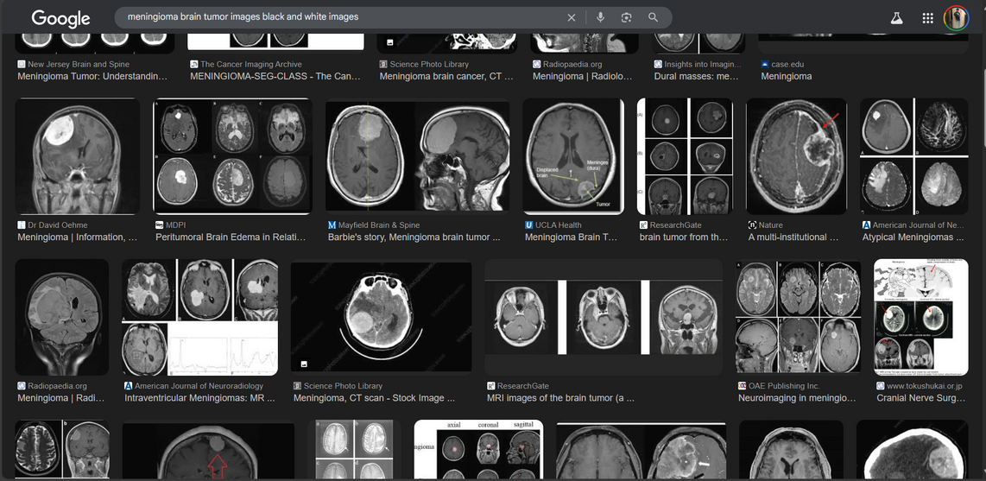
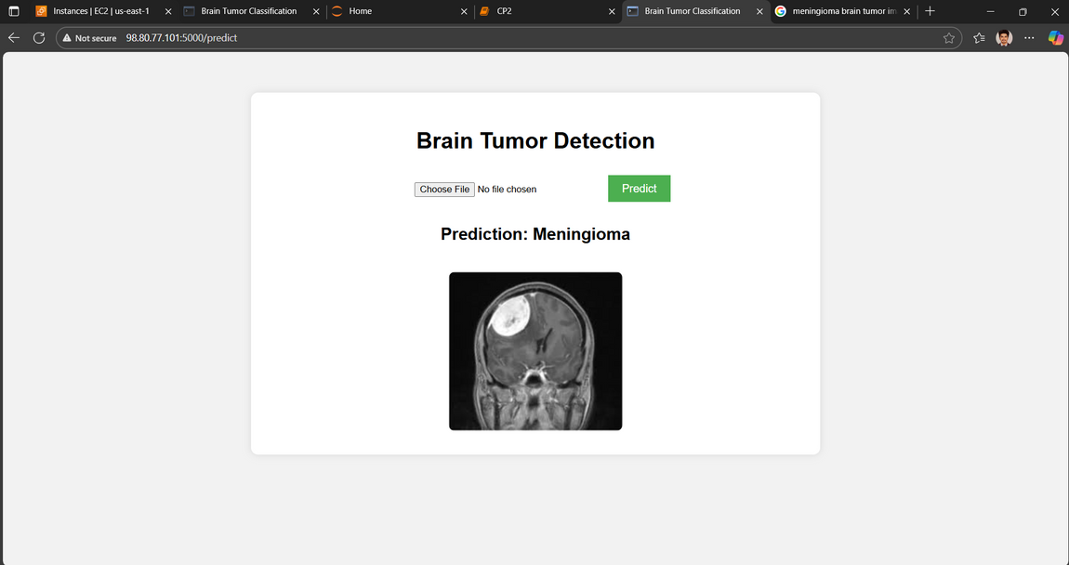
Selecting a random image from
Google images
Predicting the class of the MRI image

Slide 15
Train on a larger and more diverse MRI dataset for better generalization.
Deploy the system with real-time MRI analysis capabilities in hospitals via cloud (AWS, Streamlit, etc.).
Extend the system to classify other types of brain abnormalities.
Add tumor segmentation for precise location identification.
FUTURE
SCOPE

Slide 16
Conclusion
This project helped to build an accurate model to classify brain tumors from MRI images, helping doctors to make quicker and better decisions. The results can improve early diagnosis and treatment planning, ultimately benefit patients and support further research in medical imaging.

Slide 17
References
Dataset credits:
Brain Tumour Classification
Brain Tumor MRI Dataset
Images:
A New Treatment for Some Brain Tumors | Cancer Today
Meningioma | Information, Treatment & Surgery Melbourne

Slide 18
References
Dataset credits:
Brain Tumour Classification
Brain Tumor MRI Dataset
Images:
A New Treatment for Some Brain Tumors | Cancer Today
Meningioma | Information, Treatment & Surgery Melbourne
THANK YOU

